Slide 1
Implementation of a Convolutional Neural Network on an FPGA
Binyi Wu
Faculty of Electrical and Computer Engineering
Chair of Highly-Parallel VLSI Systems and Neuro-Microelectronics
Dresden, 19.10.2018

Slide 2
Content
Motivation
Convolutional Neural Networks (CNNs)
Architecture of Convolutional Neural Network Accelerator (CNNA)
Validation and Experiment
Conclusion

Slide 3
Content
Motivation
Convolutional Neural Networks (CNNs)
Architecture of Convolutional Neural Network Accelerator (CNNA)
Validation and Experiment
Conclusion

Slide 4
Motivation
Convolutional neural networks (CNNs)
  (+): achieve near or even beyond human performance
  (-): at the cost of high computational complexity.
  Making running CNNs in mobile device impossible
  -> Design a CNN Accelerator (CNNA)

Slide 5
Content
Motivation
Convolutional Neural Networks (CNNs)
Architecture of Convolutional Neural Network Accelerator (CNNA)
Validation and Experiment
Conclusion

Slide 6
Convolutional Neural Networks (CNNs)
  Structure of CNNs
Input Layer
Hidden Layer
Hidden Layer
Output Layer
CONV: convolutional layer
NONL: non-linearity layer
POOL: pooling layer
FC: fully connected layer
LOSS: loss layer
CONV
NONL
POOL
CONV
NONL
POOL
CONV
NONL
FC
LOSS
Computation Amount: CONV >> Other Layers

Slide 7
Convolutional Neural Networks (CNNs)
  CONV: convolutional layer
Filters_1
Neuron Activation
(NA)
Filters_2
Filters_3

Slide 8

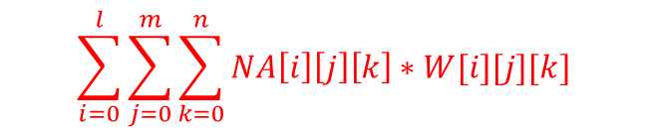

Convolutional Neural Networks (CNNs)
  CONV: Convolutional Operation (stride = 1)
Sum over element-wise multiplication
$$\sum_{i=0}^{l}{\sum_{j=0}^{m}{\sum_{k=0}^{n}{NA\left[i\right]\left[j\right]\left[k\right]∗W[i][j][k]}}}$$
100 | 101 | 102 | 103 | 104
110 | 111 | 112 | 113 | 114
120 | 121 | 122 | 123 | 124
130 | 131 | 132 | 133 | 134
140 | 141 | 142 | 143 | 144
000 | 001 | 002 | 003 | 004
010 | 011 | 012 | 013 | 014
020 | 021 | 022 | 023 | 024
030 | 031 | 032 | 033 | 034
040 | 041 | 042 | 043 | 044
100 | 101 | 102
110 | 111 | 112
120 | 121 | 122
113190 | 114288 | 115386
124170 | 125268 | 126366
135150 | 136248 | 137346
000 | 001 | 002
010 | 011 | 012
020 | 021 | 022
Neuron activation: $NA$
Filter: $W$

Slide 9
Convolutional Neural Networks (CNNs)
  CONV: Convolutional Operation (stride = 1)
stride=1
Sum over element-wise multiplication
$$\sum_{i=0}^{l}{\sum_{j=0}^{m}{\sum_{k=0}^{n}{NA\left[i\right]\left[j\right]\left[k\right]∗W[i][j][k]}}}$$
100 | 101 | 102 | 103 | 104
110 | 111 | 112 | 113 | 114
120 | 121 | 122 | 123 | 124
130 | 131 | 132 | 133 | 134
140 | 141 | 142 | 143 | 144
000 | 001 | 002 | 003 | 004
010 | 011 | 012 | 013 | 014
020 | 021 | 022 | 023 | 024
030 | 031 | 032 | 033 | 034
040 | 041 | 042 | 043 | 044
100 | 101 | 102
110 | 111 | 112
120 | 121 | 122
113190 | 114288 | 115386
124170 | 125268 | 126366
135150 | 136248 | 137346
000 | 001 | 002
010 | 011 | 012
020 | 021 | 022
Neuron activation: $NA$
Filter: $W$

Slide 10
Convolutional Neural Networks (CNNs)
  CONV: Convolutional Operation (stride = 1)
stride=1
Sum over element-wise multiplication
$$\sum_{i=0}^{l}{\sum_{j=0}^{m}{\sum_{k=0}^{n}{NA\left[i\right]\left[j\right]\left[k\right]∗W[i][j][k]}}}$$
100 | 101 | 102 | 103 | 104
110 | 111 | 112 | 113 | 114
120 | 121 | 122 | 123 | 124
130 | 131 | 132 | 133 | 134
140 | 141 | 142 | 143 | 144
000 | 001 | 002 | 003 | 004
010 | 011 | 012 | 013 | 014
020 | 021 | 022 | 023 | 024
030 | 031 | 032 | 033 | 034
040 | 041 | 042 | 043 | 044
100 | 101 | 102
110 | 111 | 112
120 | 121 | 122
113190 | 114288 | 115386
124170 | 125268 | 126366
135150 | 136248 | 137346
000 | 001 | 002
010 | 011 | 012
020 | 021 | 022
stride=1
Neuron activation: $NA$
Filter: $W$

Slide 11
Convolutional Neural Networks (CNNs)
  CONV: Convolutional Operation (stride = 1)
stride=1
Sum over element-wise multiplication
$$\sum_{i=0}^{l}{\sum_{j=0}^{m}{\sum_{k=0}^{n}{NA\left[i\right]\left[j\right]\left[k\right]∗W[i][j][k]}}}$$
100 | 101 | 102 | 103 | 104
110 | 111 | 112 | 113 | 114
120 | 121 | 122 | 123 | 124
130 | 131 | 132 | 133 | 134
140 | 141 | 142 | 143 | 144
000 | 001 | 002 | 003 | 004
010 | 011 | 012 | 013 | 014
020 | 021 | 022 | 023 | 024
030 | 031 | 032 | 033 | 034
040 | 041 | 042 | 043 | 044
100 | 101 | 102
110 | 111 | 112
120 | 121 | 122
113190 | 114288 | 115386
124170 | 125268 | 126366
135150 | 136248 | 137346
000 | 001 | 002
010 | 011 | 012
020 | 021 | 022
stride=1
Neuron activation: $NA$
Filter: $W$

Slide 12
Convolutional Neural Networks (CNNs)
  CONV: Convolutional Operation (stride = 1)
stride=1
Sum over element-wise multiplication
$$\sum_{i=0}^{l}{\sum_{j=0}^{m}{\sum_{k=0}^{n}{NA\left[i\right]\left[j\right]\left[k\right]∗W[i][j][k]}}}$$
100 | 101 | 102 | 103 | 104
110 | 111 | 112 | 113 | 114
120 | 121 | 122 | 123 | 124
130 | 131 | 132 | 133 | 134
140 | 141 | 142 | 143 | 144
000 | 001 | 002 | 003 | 004
010 | 011 | 012 | 013 | 014
020 | 021 | 022 | 023 | 024
030 | 031 | 032 | 033 | 034
040 | 041 | 042 | 043 | 044
100 | 101 | 102
110 | 111 | 112
120 | 121 | 122
113190 | 114288 | 115386
124170 | 125268 | 126366
135150 | 136248 | 137346
000 | 001 | 002
010 | 011 | 012
020 | 021 | 022
stride=1
Neuron activation: $NA$
Filter: $W$

Slide 13
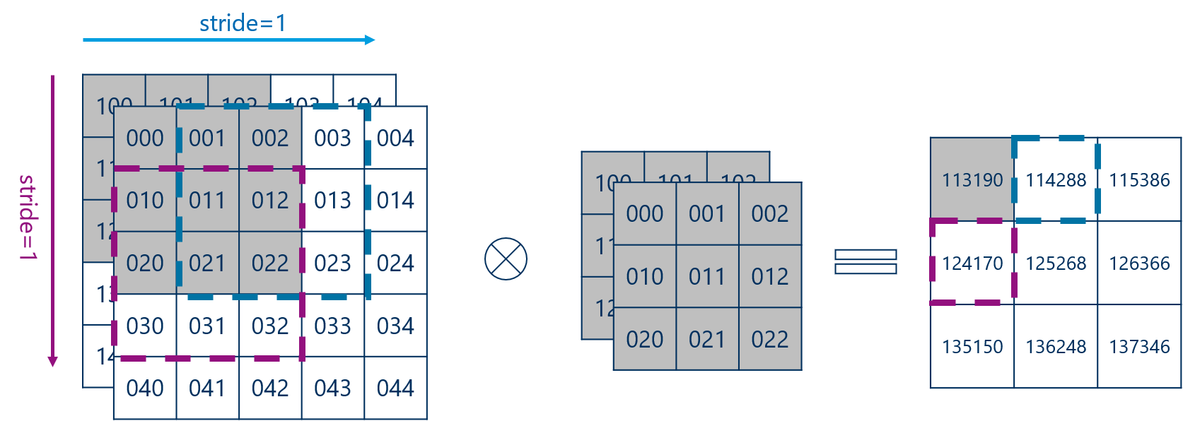
Convolutional Neural Networks (CNNs)
  CONV: Data Reuse - Filter

Slide 14
Convolutional Neural Networks (CNNs)
  CONV: Data Reuse - Filter
filter is reused 9 times

Slide 15
Convolutional Neural Networks (CNNs)
  CONV: Data Reuse – Neuron Activation
Most elements are used more than one times.

Slide 16
Convolutional Neural Networks (CNNs)
  CONV: Data Reuse – Neuron Activation
Filters
NA
NA: reused 4 times

Slide 17

Convolutional Neural Networks (CNNs)
  FC: Mathematical Operation
  Matrix Multiplication $a∗b$

Slide 18



Convolutional Neural Networks (CNNs)
  FC: Data Reuse
  Each row of $a$ is reused multi-times by columns of $b$.
  2. $b$ is reused multi-times by rows of $a$.
$$a$$
$$b$$

Slide 19
Content
Motivation
Convolutional Neural Networks (CNNs)
Architecture of Convolutional Neural Network Accelerator (CNNA)
Validation and Experiment
Conclusion

Slide 20
Architecture of CNNA
  Architecture Concept
Data Reuse

Slide 21
Architecture of CNNA
  CNNA System
Memory
CPU
cnna_start
CNN
Accelerator
(CNNA)
cnna_finish

Slide 22
Architecture of CNNA
  CNNA Limitation
CNNA can only accelerate
- convolutional layer (CONV)
- and fully-connected layer (FC).

Slide 23
Architecture of CNNA
  General Architecture
Memory Control/
Data In (128-bit)
CNNA Control Unit
Distributor
Quad Computation Unit Set
Memory Data Out
(512-bit)
CPU CNNA Interface

Slide 24
Architecture of CNNA
  CNNA Control Unit
Memory Control/
Data In (128-bit)
CNNA Control Unit
Distributor
Quad Computation Unit Set
Memory Data Out
(512-bit)
CPU CNNA Interface

Slide 25
CNNA Control Unit
mem_rd_data(128)
NA: Neuron Activation
mem_addr(8)
Address Generator
mem_rd_en
Start and configuration Phase
FSM
Control Logic
Configuration
Register
Set
cpu_to_cnna
CNNA Control Unit

Slide 26
CNNA Control Unit
NA: Neuron Activation
Address Generator
Layer Reset Phase
FSM
Control Logic
Configuration
Register
Set
CNNA Control Unit

Slide 27
CNNA Control Unit
mem_rd_data(128)
NA: Neuron Activation
“Distributor”
mem_addr(8)
Address Generator
NA Load
Control
NA Fetch Control
mem_rd_en
Computation
Unit
Control
Filter Load Phase
mem_wr_en
FSM
Control Logic
Configuration
Register
Set
All filters will be completed cached.
Filter Load
control
“Distributor”
CNNA Control Unit

Slide 28
CNNA Control Unit
mem_rd_data(128)
NA: Neuron Activation
“Distributor”
mem_addr(8)
Address Generator
NA Load
Control
“Distributor”
NA Fetch Control
mem_rd_en
Computation
Unit
Control
Neuron Activation (NA) Load Phase
FSM
Control Logic
Configuration
Register
Set
As the NA Cache is not large enough, only part of NA will be cached.
Filter Load
control
CNNA Control Unit

Slide 29
CNNA Control Unit
mem_rd_data(128)
NA: Neuron Activation
“Distributor”
mem_addr(8)
Address Generator
NA Load
Control
“Distributor”
NA Fetch Control
“Distributor”
Memory read and write operations are staggered from each other.
mem_rd_en
Computation
Unit
Control
NA Fetch and Compute Phase
mem_wr_en
FSM
Control Logic
Configuration
Register
Set
“Distributor”
NA Fetch
Compute
Filter Load
control
Write result
Load the remaining NA
CNNA Control Unit

Slide 30
CNNA Control Unit
NA: Neuron Activation
Address Generator
NA Load
Control
NA Fetch Control
Computation
Unit
Control
CNNA finish Phase
FSM
Control Logic
Configuration
Register
Set
cnna_to_cpu
Filter Load
control
CNNA Control Unit

Slide 31
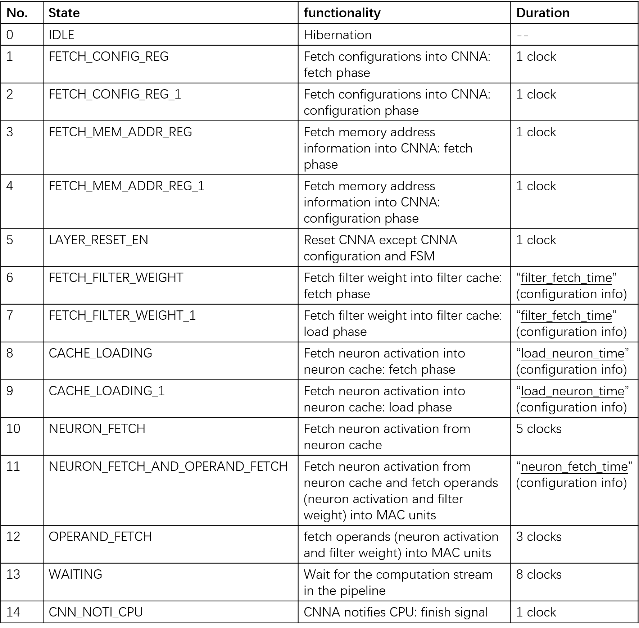
CNNA Control Unit: FSM
From Configuration Register Set

Slide 32
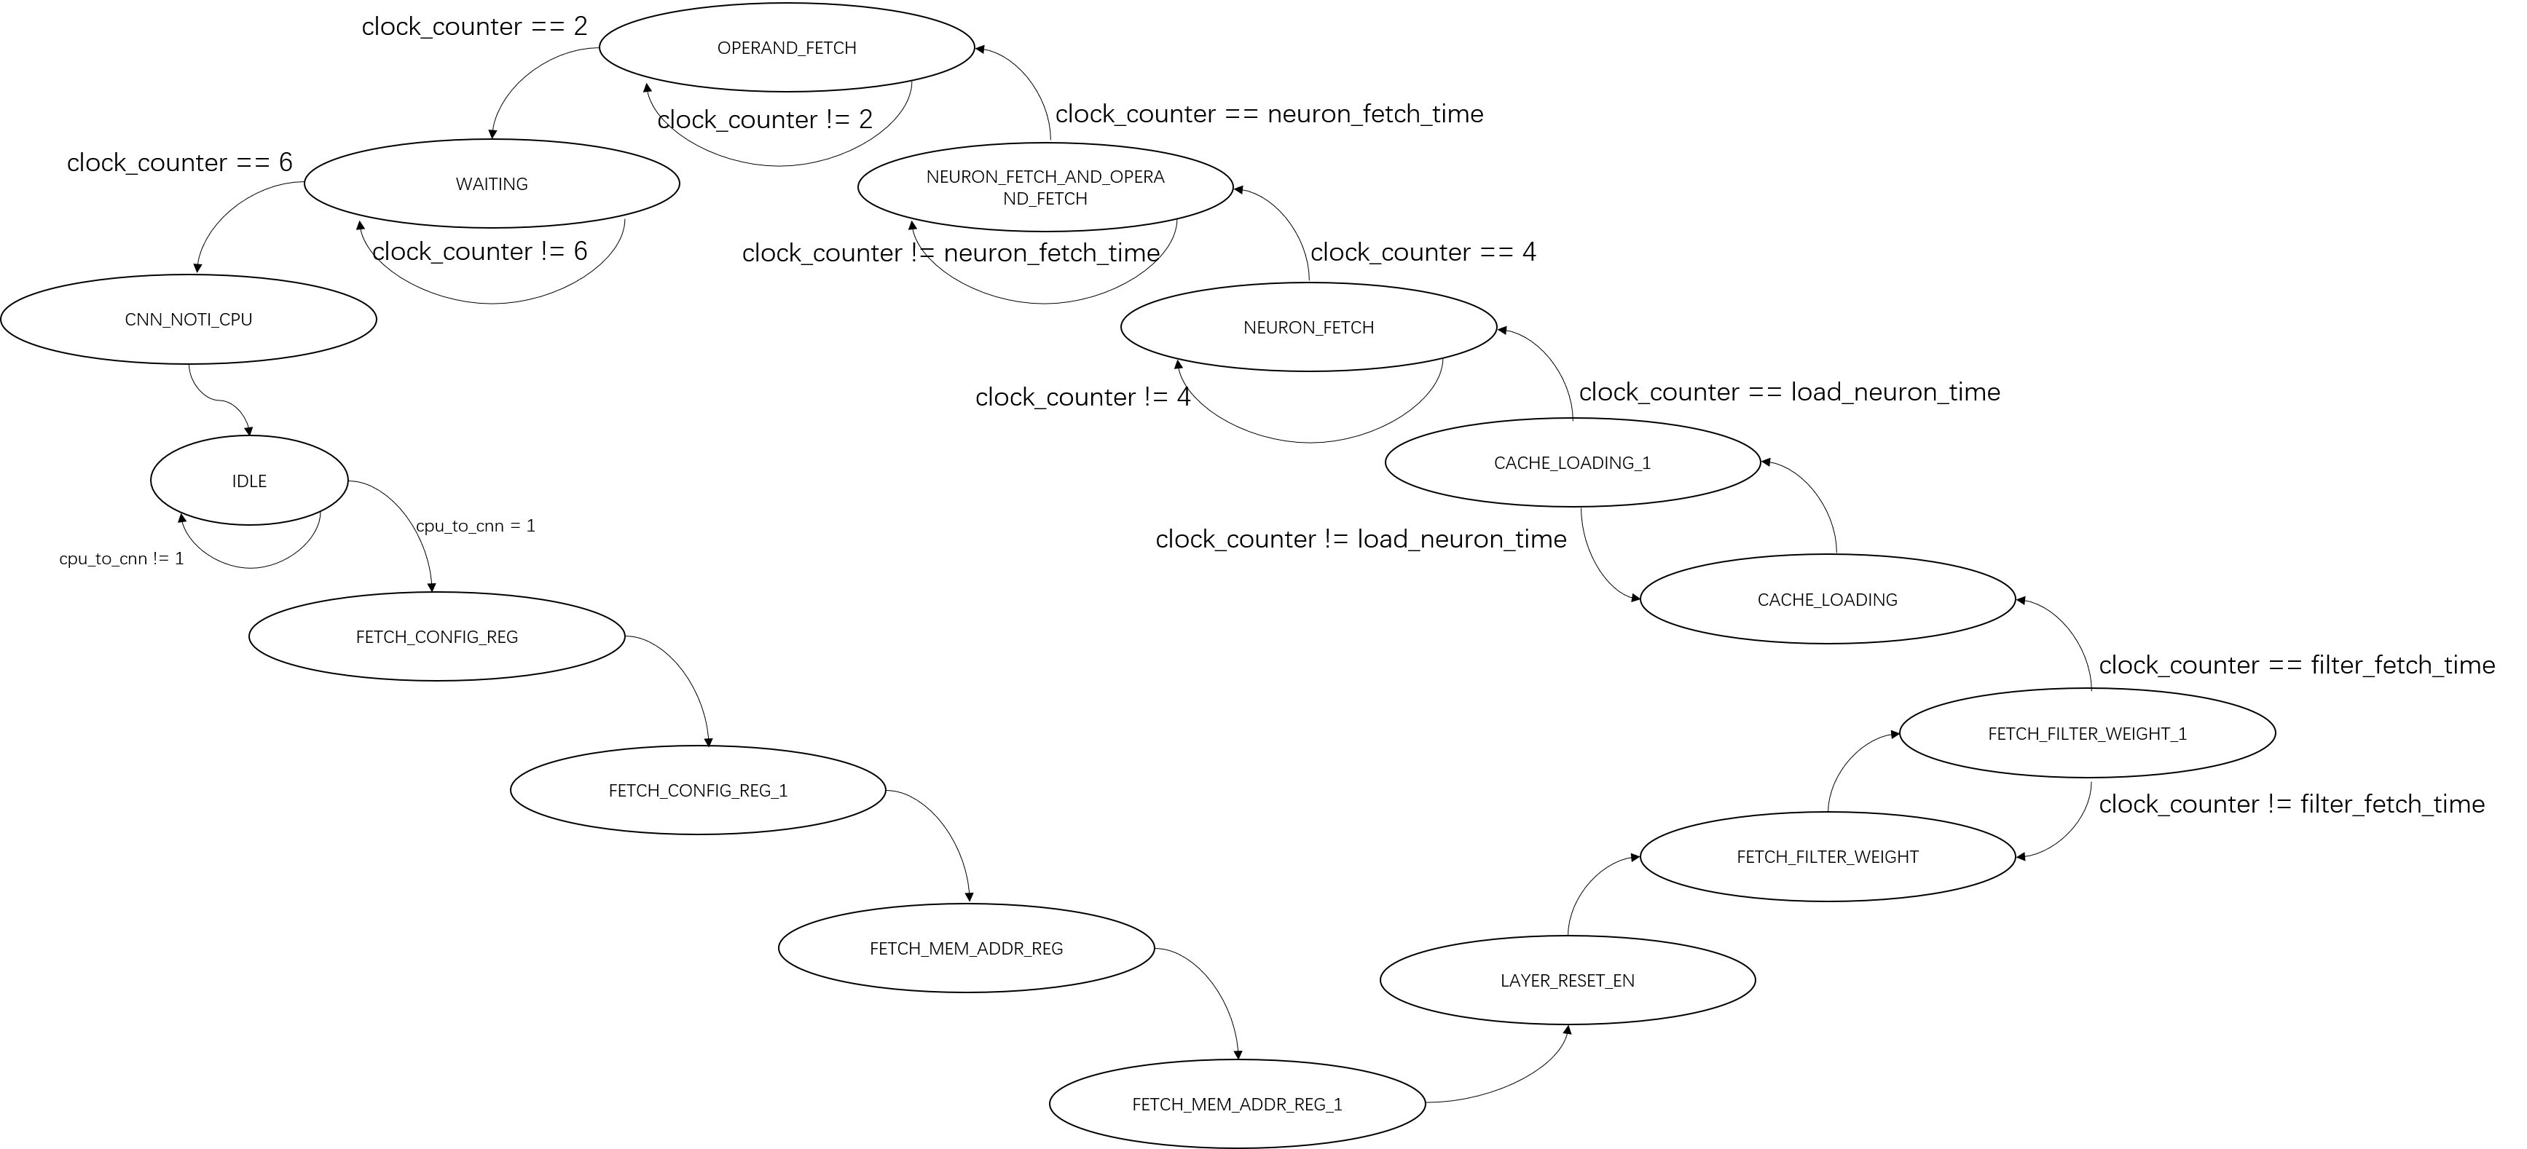
CNNA Control Unit: FSM

Slide 33
Architecture of CNNA
  Distributor
Memory Control/
Data In (128-bit)
CNNA Control Unit
Distributor
Quad Computation Unit Set
Memory Data Out
(512-bit)

Slide 34
Architecture of CNNA
  Distributor
  Distribute signal (e.g. memory data) to 16 Computation Units; Each unit occupies 8-bit memory bus.
  Control signal gating to 16 Computation Units, saving power consumption.

Slide 35
Architecture of CNNA
  Quad Computation Unit Set
Memory Control/
Data In (128-bit)
CNNA Control Unit
Distributor
Quad Computation Unit Set
Memory Data Out
(512-bit)

Slide 36
Computation Unit
“memory bus”(8-bit)
“NA Load Control”
NA Cache
“NA Fetch Control”
NA Fetch Unit
“Computation Unit Control”
cu_control
mac_en
“Filter Load Control”
Operand Fetch
Control
Filter Weight Cache
MAC Array
Unit
TF Adder
Array
Unit
1st result
1st filter, Xthchannel
2nd filter, Xth channel
3rd filter, Xth channel
4th filter, Xth channel
5th filter, Xth channel
…
16th filter, Xth channel
2nd result
Determine if NA is 0 to choose the next operation:
Skip and wait for next NA
Computing
3rd result
4th result
5th result
…
…
16 MACs
…
…
16th result
TensorFlow
Quantization
Unit
Computation Unit

Slide 37
Quad Computation Unit
Accumulator Adder
Computation Unit
control signal
“Distributor”
Computation Unit
control signal
“Distributor”
Computation Unit
control signal
“Distributor”
Computation Unit
control signal
“Distributor”
Quad Computation Unit

Slide 38
Quad Computation Unit Set
Accumulator Adder
Accumulator Adder
Computation Unit
Quad
Computation Unit
control signal
control signal
“Distributor”
“Distributor”
Computation Unit
Quad
Computation Unit
control signal
control signal
“Distributor”
“Distributor”
4 x 4 = 16 Computation Units
Computation Unit
Quad
Computation Unit
control signal
control signal
“Distributor”
“Distributor”
Computation Unit
Quad
Computation Unit
control signal
control signal
“Distributor”
“Distributor”
Quad Computation Unit
Quad Computation Unit Set

Slide 39
Content
Motivation
Convolutional Neural Networks (CNNs)
Architecture of Convolutional Neural Network Accelerator (CNNA)
Validation and Experiment
Conclusion

Slide 40
Validation and Experiment
  Validation System
FPGA
UDP Controller
cnna_begin
CNNA
cnna_end
Validation Program
(Python, TensorFlow, UDP protocol )
SRAM-I
(128-bit)
DATA
DATA
SRAM-O
(512-bit)
DATA
DATA

Slide 41
Validation and Experiment
  Validation System
FPGA
UDP Controller
cnna_begin
CNNA
cnna_end
Validation Program
(Python, TensorFlow, UDP protocol )
SRAM-I
(128-bit)
DATA
DATA
SRAM-O
(512-bit)
DATA
DATA

Slide 42





Validation and Experiment
  CONV Mapping: Data Dimension
$$filter_{0}$$
$$\left[\begin{matrix}NA_{height} & NA_{width} & in_{channels}\end{matrix}\right]$$
$$filter_{1}$$
$$filter_{2}$$
NA
…
$$\left[\begin{matrix}filter_{height} & filter_{width} & \begin{matrix}in_{channels} & out_{channels}\end{matrix}\end{matrix}\right]$$
$$filter_{N}$$

Slide 43


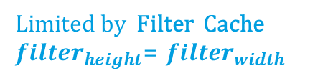



Validation and Experiment
  CONV Mapping: Limitation
stride = 1
$$\left[\begin{matrix}NA_{height} & NA_{width} & in_{channels}\end{matrix}\right]$$
$≤16$ Limited by the number of Computation Units
$$No Limitation$$
$≤32$ Limited by NA Cache
$$\left[\begin{matrix}filter_{height} & filter_{width} & \begin{matrix}in_{channels} & out_{channels}\end{matrix}\end{matrix}\right]$$
$≤16$ Limited by the number of MACs in a Computation Unit
$≤16$ Limited by the number of Computation Units
$$≤6$$
Limited by Filter Cache
$filter_{height}$= $filter_{width}$
$$≤6$$

Slide 44




CONV Mapping
NA, channel_0
CU_0
AA_0
AA_1
AA_2
…
AA_15
filter_0, channel_0
filter_1, channel_0
filter_2, channel_0
…
filter_15, channel_0
MAC_0
MAC_1
MAC_2
…
MAC_15
QA_0
QA_1
QA_2
…
QA_15
$$filter_{0}$$
$$filter_{1}$$
NA, channel_1
CU_1
filter_0, channel_1
filter_1, channel_1
filter_2, channel_1
…
filter_15, channel_1
MAC_0
MAC_1
MAC_2
…
MAC_15
QA_0
QA_1
QA_2
…
QA_15
$$filter_{2}$$
NA
…
Part of NA will be cached.
…
NA, channel_15
CU_15
filter_0, channel_15
filter_1, channel_15
filter_2, channel_15
…
filter_15, channel_15
MAC_0
MAC_1
MAC_2
…
MAC_15
QA_0
QA_1
QA_2
…
QA_15
$$filter_{15}$$
Filters need to be fully cached.

Slide 45
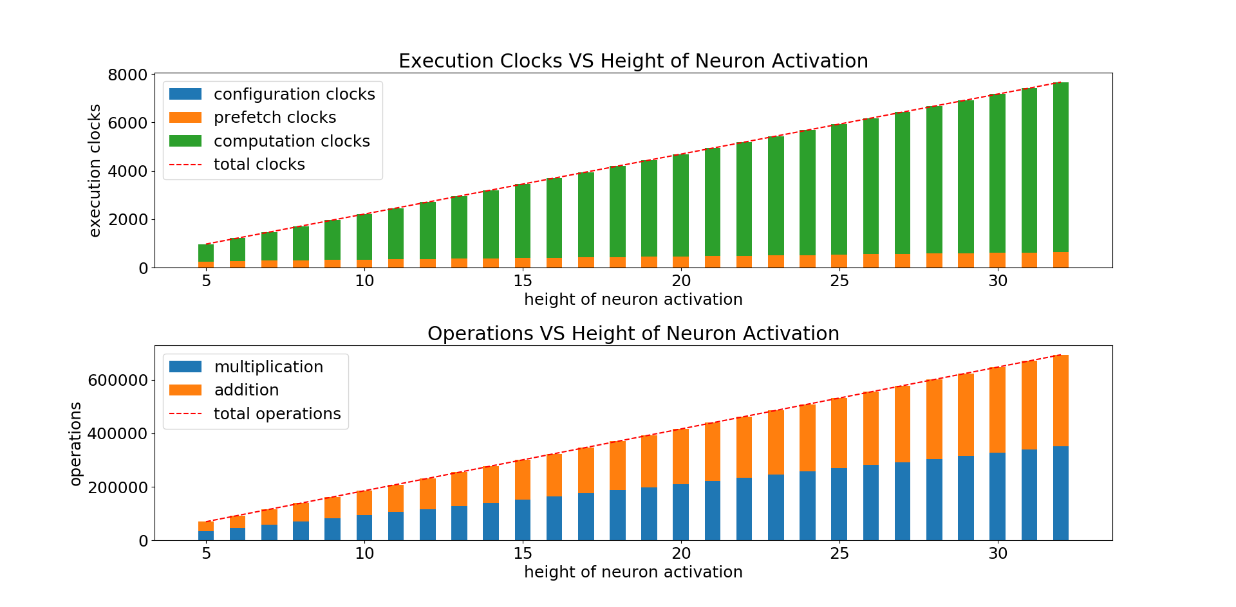


Validation and Experiment
  Benchmark: CONV
$$\left[\begin{matrix}NA_{height} & NA_{width} & in_{channels}\end{matrix}\right]$$
$$=\left[\begin{matrix}X & 28 & 5\end{matrix}\right]$$
$$\left[\begin{matrix}filter_{height} & filter_{width} & \begin{matrix}in_{channels} & out_{channels}\end{matrix}\end{matrix}\right]$$
$$=\left[\begin{matrix}3 & 3 & \begin{matrix}5 & 10\end{matrix}\end{matrix}\right]$$
computation clocks >> prefetch clocks
Acceleration: up to around 100
Bottleneck: Computing resource

Slide 46
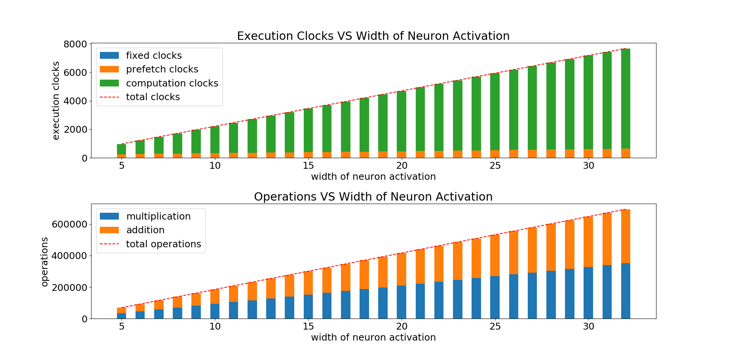

Validation and Experiment
  Benchmark: CONV
$$\left[\begin{matrix}NA_{height} & NA_{width} & in_{channels}\end{matrix}\right]$$
$$=\left[\begin{matrix}28 & X & 5\end{matrix}\right]$$
$$\left[\begin{matrix}filter_{height} & filter_{width} & \begin{matrix}in_{channels} & out_{channels}\end{matrix}\end{matrix}\right]$$
$$=\left[\begin{matrix}3 & 3 & \begin{matrix}5 & 10\end{matrix}\end{matrix}\right]$$
computation clocks >> prefetch clocks
Acceleration: up to around 100
Bottleneck: Computing resource

Slide 47
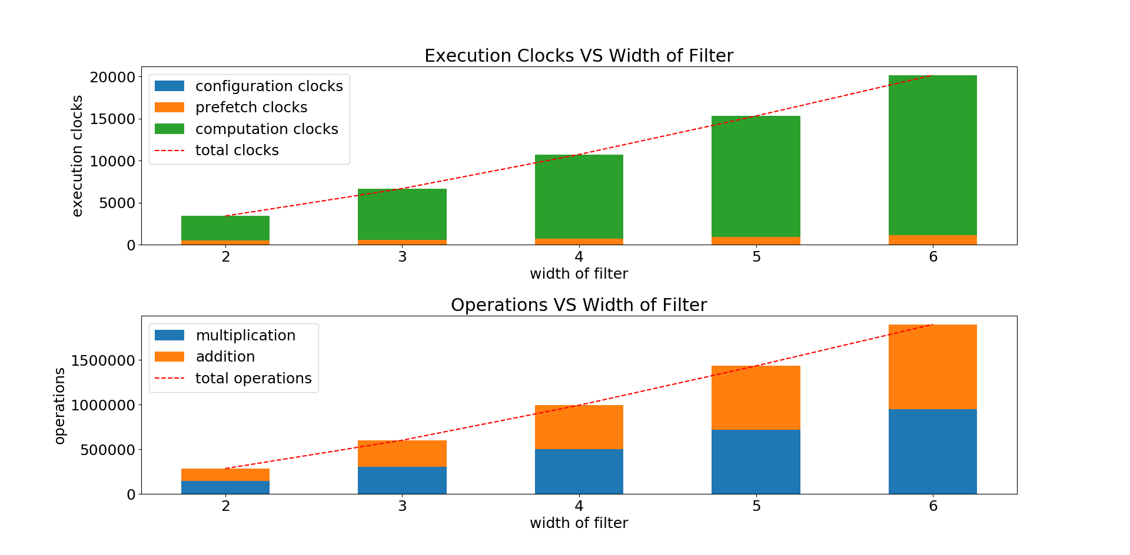


Validation and Experiment
  Benchmark: CONV
$$\left[\begin{matrix}NA_{height} & NA_{width} & in_{channels}\end{matrix}\right]$$
$$=\left[\begin{matrix}28 & 28 & 5\end{matrix}\right]$$
$$\left[\begin{matrix}filter_{height} & filter_{width} & \begin{matrix}in_{channels} & out_{channels}\end{matrix}\end{matrix}\right]$$
$$=\left[\begin{matrix}X & X & \begin{matrix}5 & 10\end{matrix}\end{matrix}\right]$$
computation clocks >> prefetch clocks
Acceleration: up to around 100
Bottleneck: Computing resource

Slide 48
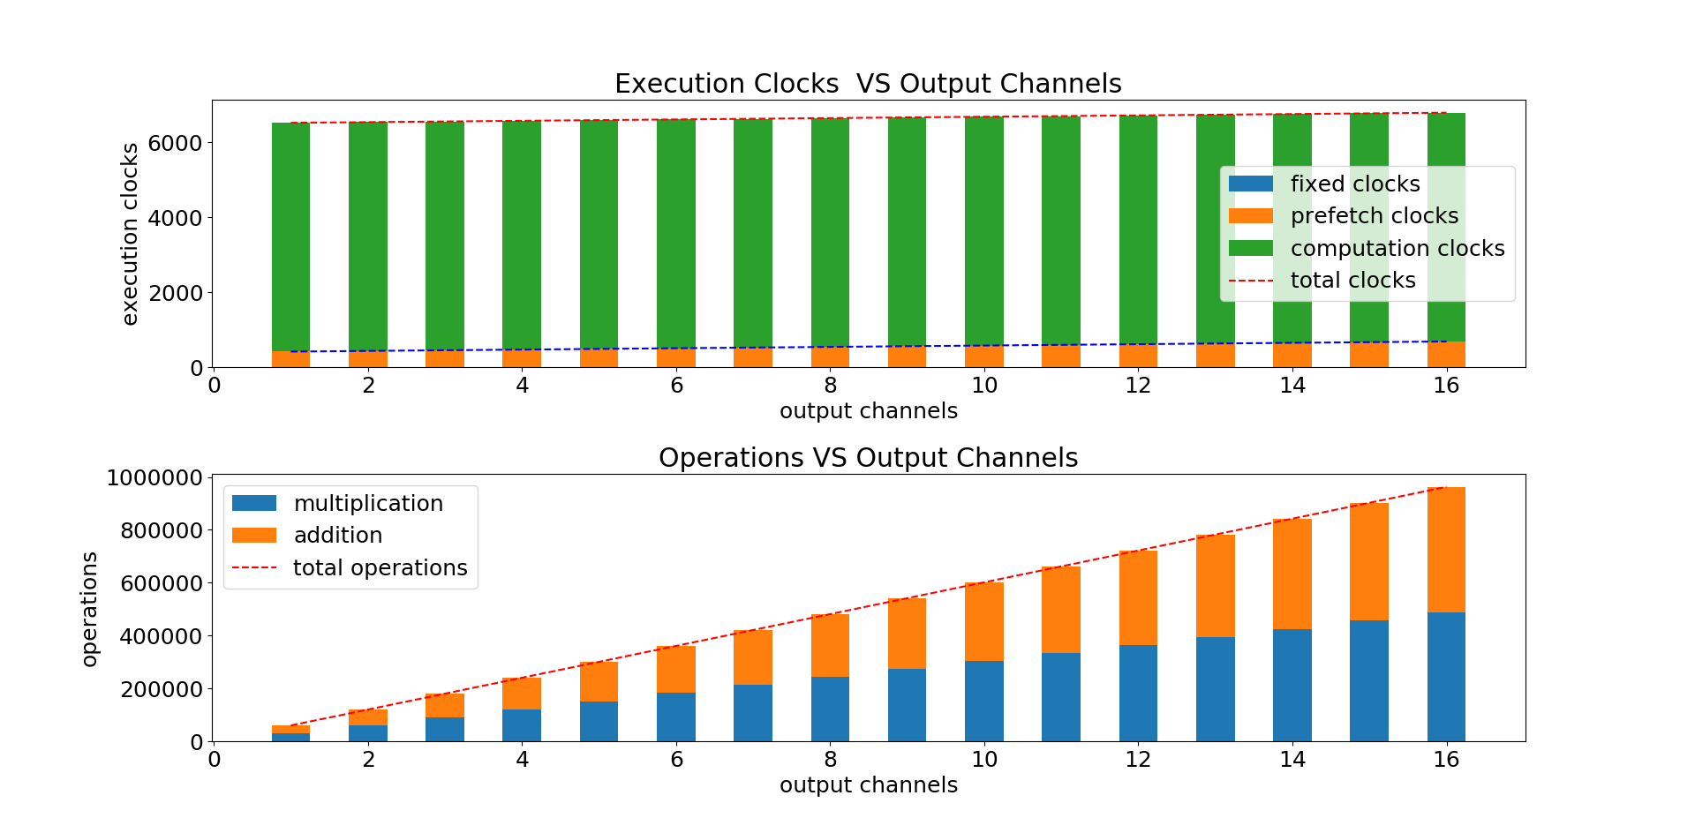

Validation and Experiment
  Benchmark: CONV
$$\left[\begin{matrix}NA_{height} & NA_{width} & in_{channels}\end{matrix}\right]$$
$$=\left[\begin{matrix}28 & 28 & 5\end{matrix}\right]$$
$$\left[\begin{matrix}filter_{height} & filter_{width} & \begin{matrix}in_{channels} & out_{channels}\end{matrix}\end{matrix}\right]$$
$$=\left[\begin{matrix}3 & 3 & \begin{matrix}5 & X\end{matrix}\end{matrix}\right]$$
computation clocks >> prefetch clocks
Acceleration: up to around 150
-> More MACs are used
Bottleneck: Computing resource

Slide 49
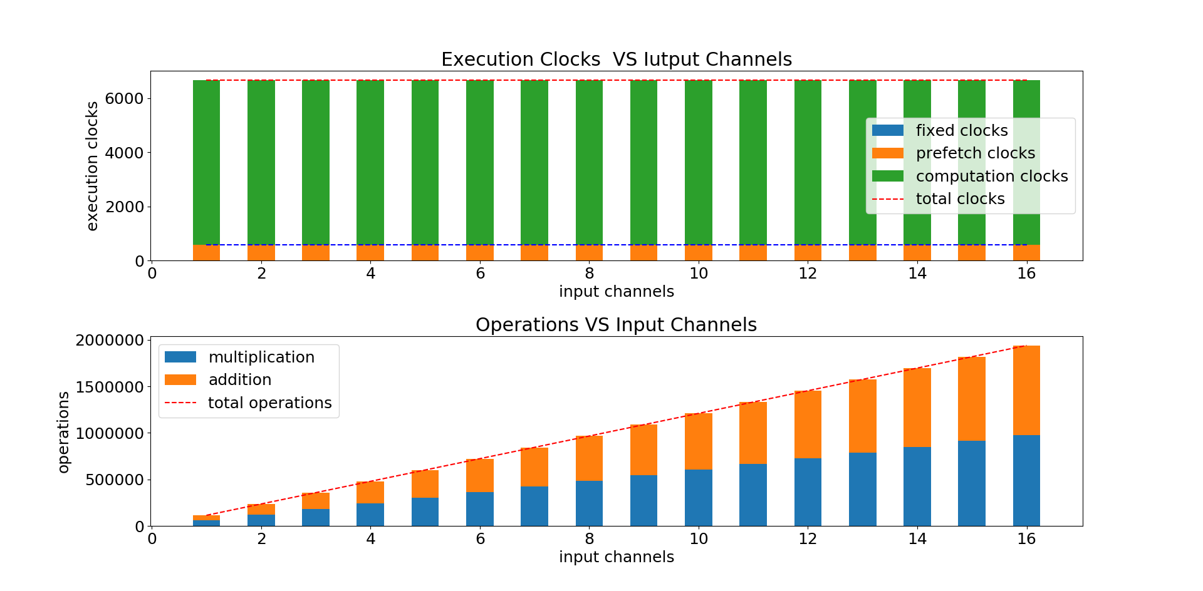


Validation and Experiment
  Benchmark: CONV
$$\left[\begin{matrix}NA_{height} & NA_{width} & in_{channels}\end{matrix}\right]$$
$$=\left[\begin{matrix}28 & 28 & X\end{matrix}\right]$$
$$\left[\begin{matrix}filter_{height} & filter_{width} & \begin{matrix}in_{channels} & out_{channels}\end{matrix}\end{matrix}\right]$$
$$=\left[\begin{matrix}3 & 3 & \begin{matrix}X & 10\end{matrix}\end{matrix}\right]$$
computation clocks >> prefetch clocks
Acceleration: up to around 300
-> More MACs are used
Bottleneck: Computing resource

Slide 50







Validation and Experiment
M
  FC Mapping
…
N
M
 |  |  | …
a [1, N]
r [1, M]
N
$N$ elements are separated into $P$ parts.
Each part has $\frac{N}{P}=P_{h}∗P_{w}$ elements.
b [N, M]
Each column has $N$ elements and separated into $P$ parts.
$$a\left[1,N\right]=a\left[\begin{matrix}P_{h} & P_{w} & P\end{matrix}\right]$$
Each part has $\frac{N}{P}=P_{h}∗P_{w}$ elements.
$$→a\left[\begin{matrix}NA_{height} & NA_{width} & in_{channels}\end{matrix}\right]$$
$$b\left[N,M\right]=b\left[\begin{matrix}\begin{matrix}P_{h} & P_{w} & P\end{matrix} & M\end{matrix}\right]$$
!!! $P_{h}$ don’t muss be equal to $P_{w}$
$$→b\left[\begin{matrix}filter_{height} & filter_{width} & \begin{matrix}in_{channels} & out_{channels}\end{matrix}\end{matrix}\right]$$

Slide 51


Validation and Experiment
  FC Mapping: Limitation
$$N≤16 ∗36=576$$
$$M≤16$$

Slide 52
FC Mapping
N
a, part_0
CU_0
AA_0
AA_1
AA_2
…
AA_15
a [1, N]
b[0], part_0
b[1], part_0
b[2], part_0
…
b[15], part_0
MAC_0
MAC_1
MAC_2
…
MAC_15
QA_0
QA_1
QA_2
…
QA_15
a [1, N] muss be fully cached.
M
a, part_1
CU_1
…
b[0], part_1
b[1], part_1
b[2], part_1
…
b[15], part_1
MAC_0
MAC_1
MAC_2
…
MAC_15
QA_0
QA_1
QA_2
…
QA_15
N
b [N, M]
b [N, M] muss be fully cached.
…
a, part_15
CU_15
b[0], part_15
b[1], part_15
b[2], part_15
…
b[15], part_15
MAC_0
MAC_1
MAC_2
…
MAC_15
QA_0
QA_1
QA_2
…
QA_15
M
 |  |  | …

Slide 53
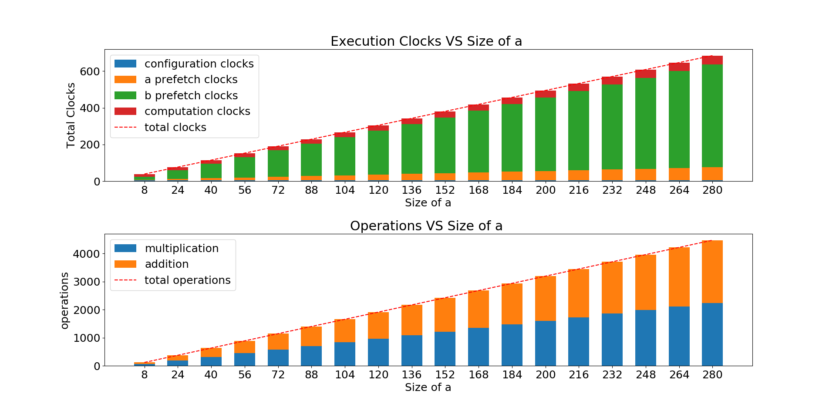



Validation and Experiment
  Benchmark: FC
$$a\left[1,N\right]=a\left[\begin{matrix}P_{h} & P_{w} & 8\end{matrix}\right]$$
$$b\left[N,8\right]=b\left[\begin{matrix}\begin{matrix}P_{h} & P_{w} & 8\end{matrix} & 8\end{matrix}\right]$$
$P_{h}∗P_{w}$ : The size of each part is variable.
prefetch clocks >> computation clocks
Acceleration: up to around 7
Bottleneck: memory bandwidth

Slide 54
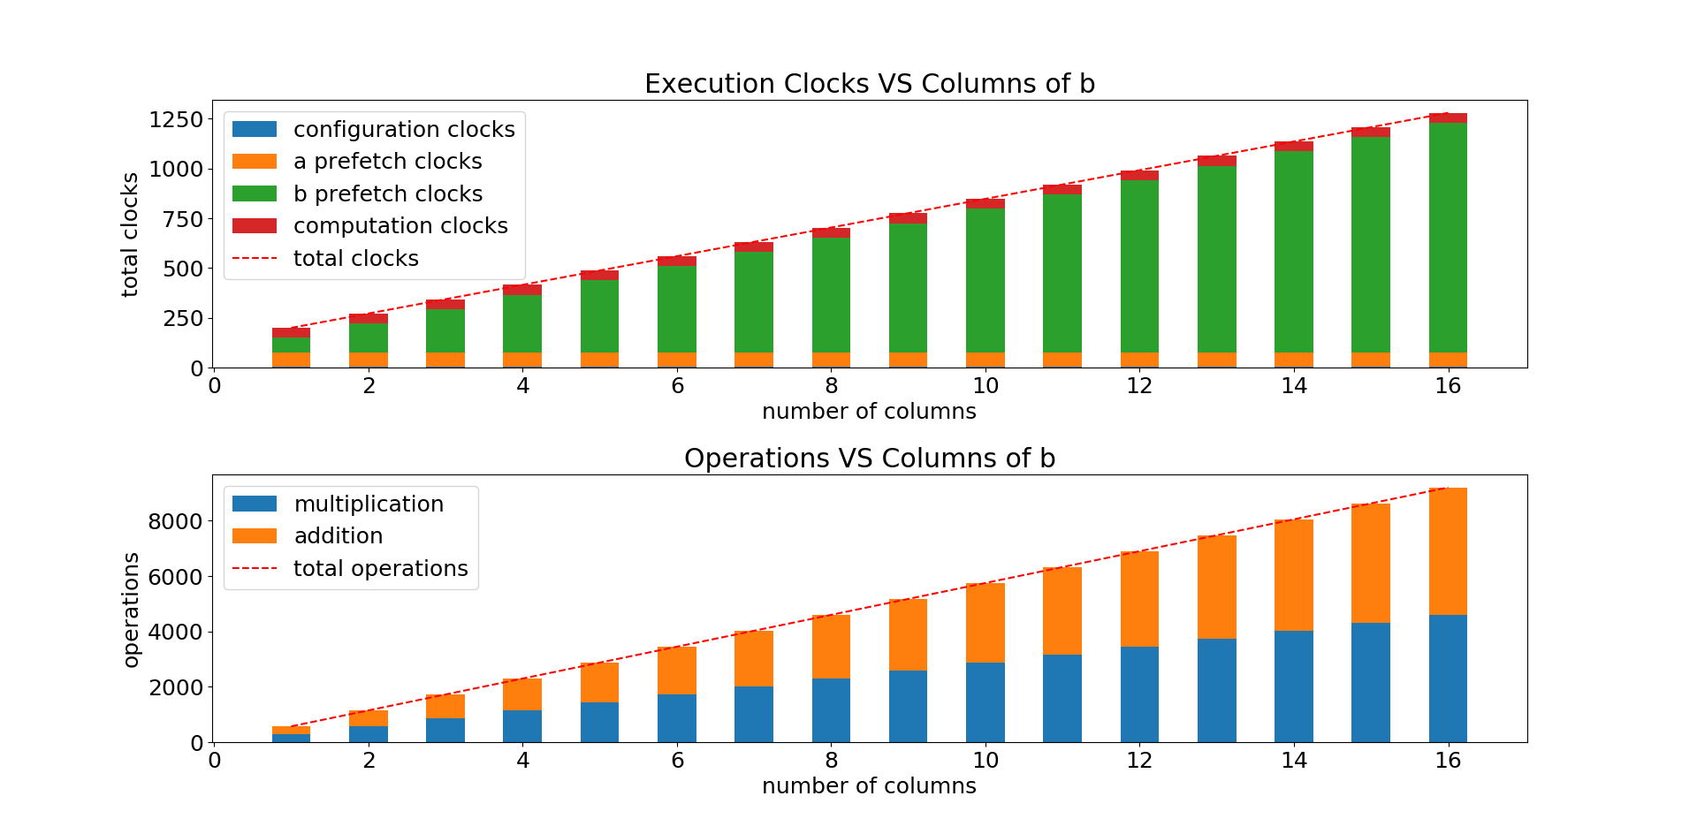



Validation and Experiment
  Benchmark: FC
$$a\left[1,N\right]=a\left[\begin{matrix}6 & 6 & 8\end{matrix}\right]$$
$$b\left[N, M\right]=b\left[\begin{matrix}\begin{matrix}6 & 6 & 8\end{matrix} & M\end{matrix}\right]$$
Number of columns of $b$ is variable.
prefetch clocks >> computation clocks
Acceleration: up to around 7
Bottleneck: memory bandwidth

Slide 55
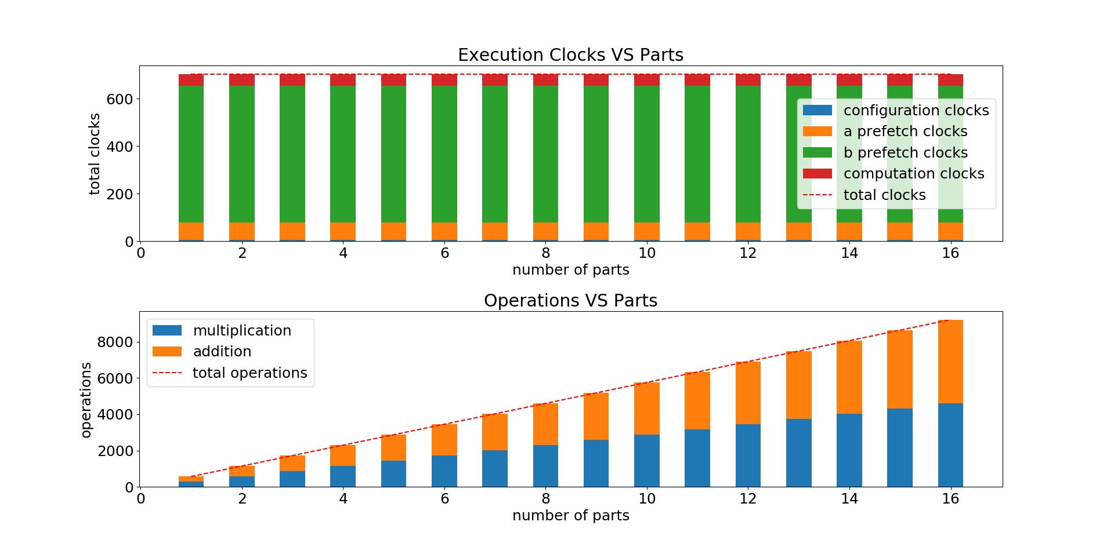


Validation and Experiment
  Benchmark: FC
$$a\left[1,N\right]=a\left[\begin{matrix}6 & 6 & P\end{matrix}\right]$$
$$b\left[N,M\right]=b\left[\begin{matrix}\begin{matrix}6 & 6 & P\end{matrix} & 8\end{matrix}\right]$$
Number of parts is variable.
prefetch clocks >> computation clocks
Acceleration: up to around 13
Bottleneck: memory bandwidth

Slide 56
Content
Motivation
Convolutional Neural Networks (CNNs)
Architecture of Convolutional Neural Network Accelerator (CNNA)
Validation and Experiment
Conclusion

Slide 57
Conclusion
  Bottleneck: CONV-computing resources, FC-memory bandwidth
  Utilization of the data reusing through
  - using cache of NA and filter;
  - putting computing resources, which share same data, in a unit.
  reduce power consumption as much as possible through
  - reducing memory operation;
  - skipping multiplication by 0.

Slide 58
Conclusion
  Improvement
  Start to compute during pre-caching
  Optimize the cache size, enable cache sharing
  Support other stride
  Add padding layer, pooling layer etc.
  …

Slide 59
Thank you for your attention!

Slide 60
Configuration

Slide 61
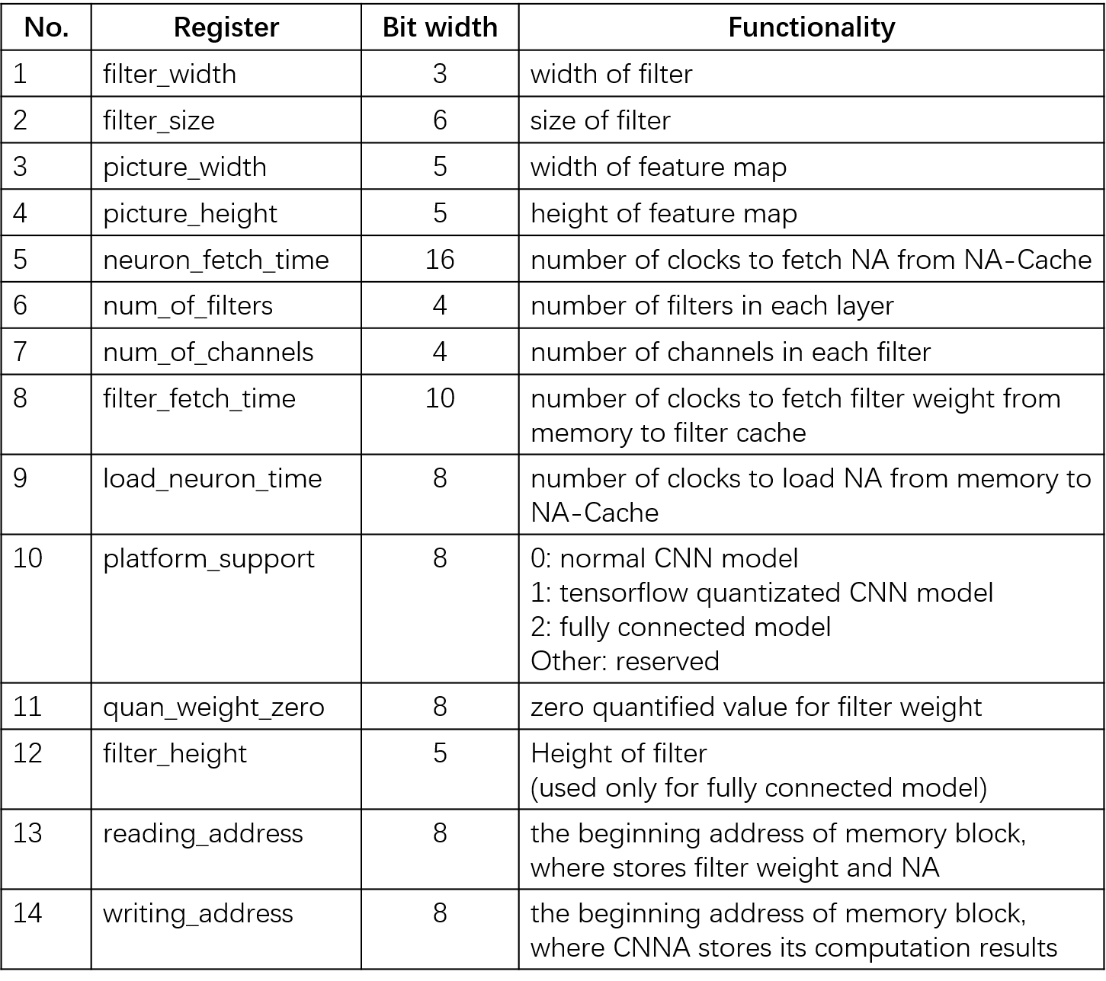
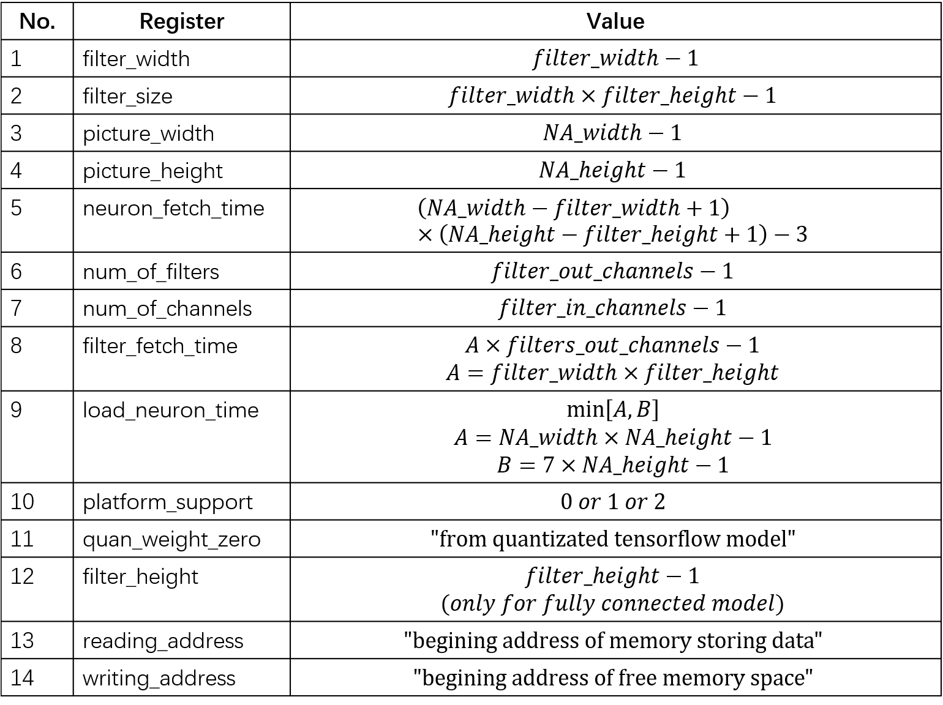
Architecture of CNNA
  CNNA Control Unit: Configuration Register Set
Register Description
How to set the value for registers?

Slide 62
Memory

Slide 63
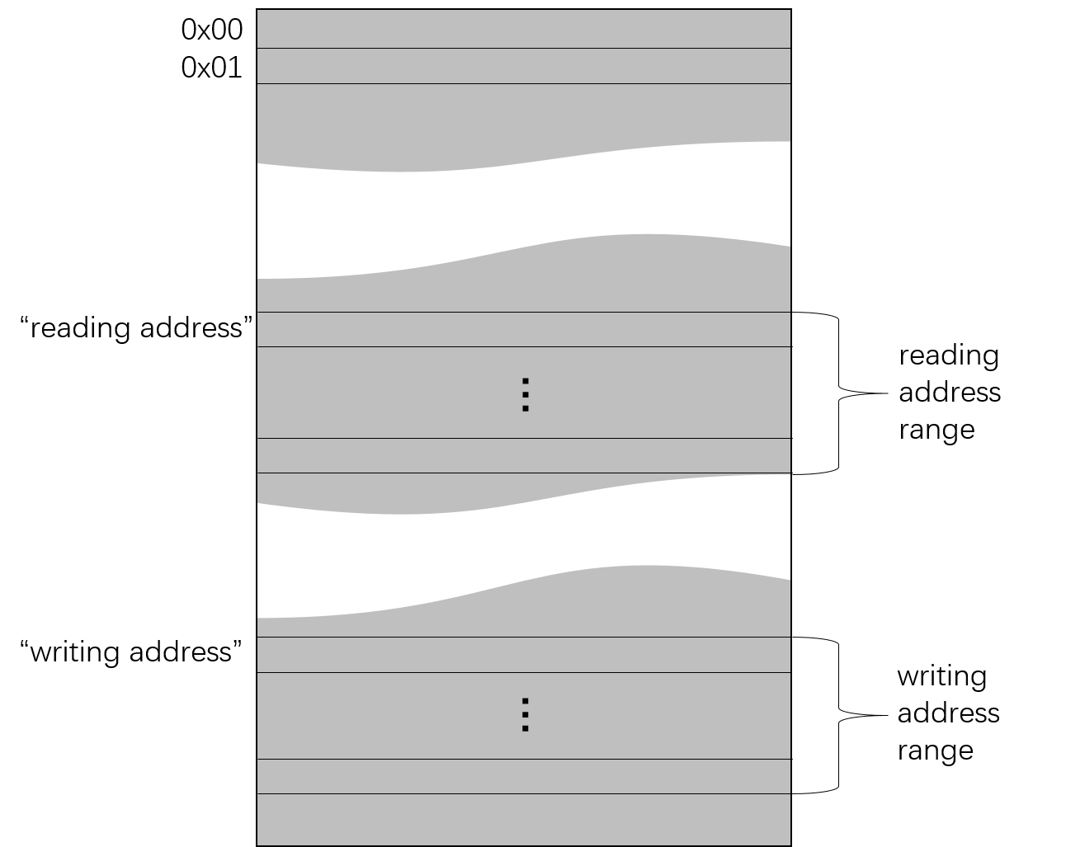
Architecture of CNNA
  Memory Arrangement
Configuration Data

Slide 64
NA Cache

Slide 65
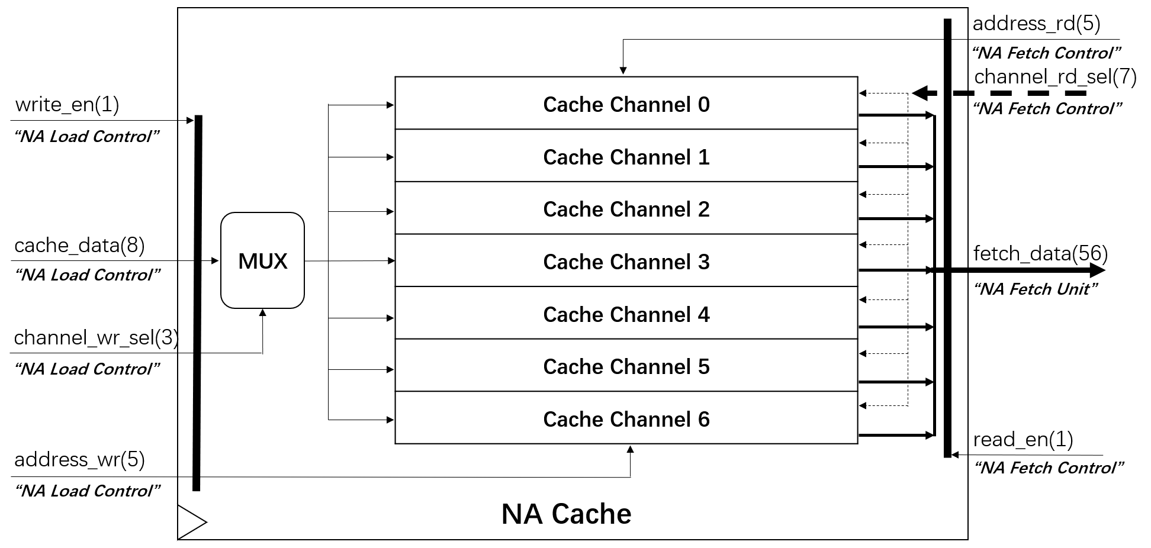
NA Cache
32 x 7 = 224 Bytes

Slide 66
NA Cache
1 | 2 | 3 | 4 | 5 | 6 | 7 | 8 | 9
11 | 12 | 13 | 14 | 15 | 16 | 17 | 18 | 19
21 | 22 | 23 | 24 | 25 | 26 | 27 | 28 | 29
11 | 12 | 13 | 14 | 15 | 16 | 17 | 18 | 19
1 | 2 | 3 | 4 | 5 | 6 | 7 | 8 | 9
1 | 1 | 1
1 | 1 | 1
1 | 1 | 1
filter
neuron activation

Slide 67
NA Cache
Pre-Caching
Channel 0
Channel 6
1 | 2 | 3 | 4 | 5 | 6 | 7
11 | 12 | 13 | 14 | 15 | 16 | 17
21 | 22 | 23 | 24 | 25 | 26 | 27
11 | 12 | 13 | 14 | 15 | 16 | 17
1 | 2 | 3 | 4 | 5 | 6 | 7
1 | 2 | 3 | 4 | 5 | 6 | 7 | 8 | 9
11 | 12 | 13 | 14 | 15 | 16 | 17 | 18 | 19
21 | 22 | 23 | 24 | 25 | 26 | 27 | 28 | 29
11 | 12 | 13 | 14 | 15 | 16 | 17 | 18 | 19
1 | 2 | 3 | 4 | 5 | 6 | 7 | 8 | 9
NA Cache
neuron activation

Slide 68
NA Cache
Stage 1
Channel 0
Channel 6
1 | 2 | 3 | 4 | 5 | 6 | 7
11 | 12 | 13 | 14 | 15 | 16 | 17
21 | 22 | 23 | 24 | 25 | 26 | 27
11 | 12 | 13 | 14 | 15 | 16 | 17
1 | 2 | 3 | 4 | 5 | 6 | 7
1 | 1 | 1
1 | 1 | 1
1 | 1 | 1
108
neuron activation

Slide 69
NA Cache
Stage 2
8 | 2 | 3 | 4 | 5 | 6 | 7
11 | 12 | 13 | 14 | 15 | 16 | 17
21 | 22 | 23 | 24 | 25 | 26 | 27
11 | 12 | 13 | 14 | 15 | 16 | 17
1 | 2 | 3 | 4 | 5 | 6 | 7
1 | 1 | 1
1 | 1 | 1
1 | 1 | 1
138
1 | 2 | 3 | 4 | 5 | 6 | 7 | 8 | 9
11 | 12 | 13 | 14 | 15 | 16 | 17 | 18 | 19
21 | 22 | 23 | 24 | 25 | 26 | 27 | 28 | 29
11 | 12 | 13 | 14 | 15 | 16 | 17 | 18 | 19
1 | 2 | 3 | 4 | 5 | 6 | 7 | 8 | 9
neuron activation
Stage 4
1 | 1 | 1
1 | 1 | 1
1 | 1 | 1
8 | 2 | 3 | 4 | 5 | 6 | 7
18 | 12 | 13 | 14 | 15 | 16 | 17
28 | 22 | 23 | 24 | 25 | 26 | 27
18 | 12 | 13 | 14 | 15 | 16 | 17
8 | 2 | 3 | 4 | 5 | 6 | 7
117
Stage 5
8 | 9 | 3 | 4 | 5 | 6 | 7
18 | 12 | 13 | 14 | 15 | 16 | 17
28 | 22 | 23 | 24 | 25 | 26 | 27
18 | 12 | 13 | 14 | 15 | 16 | 17
8 | 2 | 3 | 4 | 5 | 6 | 7
1 | 1 | 1
1 | 1 | 1
1 | 1 | 1
147

Slide 70
NA Cache
Stage 3
8 | 2 | 3 | 4 | 5 | 6 | 7
18 | 12 | 13 | 14 | 15 | 16 | 17
21 | 22 | 23 | 24 | 25 | 26 | 27
11 | 12 | 13 | 14 | 15 | 16 | 17
1 | 2 | 3 | 4 | 5 | 6 | 7
1 | 1 | 1
1 | 1 | 1
1 | 1 | 1
108
1 | 2 | 3 | 4 | 5 | 6 | 7 | 8 | 9
11 | 12 | 13 | 14 | 15 | 16 | 17 | 18 | 19
21 | 22 | 23 | 24 | 25 | 26 | 27 | 28 | 29
11 | 12 | 13 | 14 | 15 | 16 | 17 | 18 | 19
1 | 2 | 3 | 4 | 5 | 6 | 7 | 8 | 9
neuron activation

Slide 71
NA Cache
Stage 4
1 | 1 | 1
1 | 1 | 1
1 | 1 | 1
8 | 2 | 3 | 4 | 5 | 6 | 7
18 | 12 | 13 | 14 | 15 | 16 | 17
28 | 22 | 23 | 24 | 25 | 26 | 27
18 | 12 | 13 | 14 | 15 | 16 | 17
8 | 2 | 3 | 4 | 5 | 6 | 7
117
1 | 2 | 3 | 4 | 5 | 6 | 7 | 8 | 9
11 | 12 | 13 | 14 | 15 | 16 | 17 | 18 | 19
21 | 22 | 23 | 24 | 25 | 26 | 27 | 28 | 29
11 | 12 | 13 | 14 | 15 | 16 | 17 | 18 | 19
1 | 2 | 3 | 4 | 5 | 6 | 7 | 8 | 9
neuron activation

Slide 72
NA Cache
Stage 5
8 | 9 | 3 | 4 | 5 | 6 | 7
18 | 12 | 13 | 14 | 15 | 16 | 17
28 | 22 | 23 | 24 | 25 | 26 | 27
18 | 12 | 13 | 14 | 15 | 16 | 17
8 | 2 | 3 | 4 | 5 | 6 | 7
1 | 1 | 1
1 | 1 | 1
1 | 1 | 1
147
1 | 2 | 3 | 4 | 5 | 6 | 7 | 8 | 9
11 | 12 | 13 | 14 | 15 | 16 | 17 | 18 | 19
21 | 22 | 23 | 24 | 25 | 26 | 27 | 28 | 29
11 | 12 | 13 | 14 | 15 | 16 | 17 | 18 | 19
1 | 2 | 3 | 4 | 5 | 6 | 7 | 8 | 9
neuron activation

Slide 73
NA Cache
Stage 6
8 | 9 | 3 | 4 | 5 | 6 | 7
18 | 19 | 13 | 14 | 15 | 16 | 17
28 | 22 | 23 | 24 | 25 | 26 | 27
18 | 12 | 13 | 14 | 15 | 16 | 17
8 | 2 | 3 | 4 | 5 | 6 | 7
1 | 1 | 1
1 | 1 | 1
1 | 1 | 1
117
1 | 2 | 3 | 4 | 5 | 6 | 7 | 8 | 9
11 | 12 | 13 | 14 | 15 | 16 | 17 | 18 | 19
21 | 22 | 23 | 24 | 25 | 26 | 27 | 28 | 29
11 | 12 | 13 | 14 | 15 | 16 | 17 | 18 | 19
1 | 2 | 3 | 4 | 5 | 6 | 7 | 8 | 9
neuron activation

Slide 74
NA Cache
Stage 7
8 | 9 | 3 | 4 | 5 | 6 | 7
18 | 19 | 13 | 14 | 15 | 16 | 17
28 | 29 | 23 | 24 | 25 | 26 | 27
18 | 19 | 13 | 14 | 15 | 16 | 17
8 | 9 | 3 | 4 | 5 | 6 | 7
1 | 1 | 1
1 | 1 | 1
1 | 1 | 1
126
1 | 2 | 3 | 4 | 5 | 6 | 7 | 8 | 9
11 | 12 | 13 | 14 | 15 | 16 | 17 | 18 | 19
21 | 22 | 23 | 24 | 25 | 26 | 27 | 28 | 29
11 | 12 | 13 | 14 | 15 | 16 | 17 | 18 | 19
1 | 2 | 3 | 4 | 5 | 6 | 7 | 8 | 9
neuron activation

Slide 75
NA Cache
Stage 8
8 | 9 | 3 | 4 | 5 | 6 | 7
18 | 19 | 13 | 14 | 15 | 16 | 17
28 | 29 | 23 | 24 | 25 | 26 | 27
18 | 19 | 13 | 14 | 15 | 16 | 17
8 | 9 | 3 | 4 | 5 | 6 | 7
1 | 1 | 1
1 | 1 | 1
1 | 1 | 1
156

Slide 76
NA Cache
……………

Slide 77
NA Cache
Stage 15
8 | 9 | 3 | 4 | 5 | 6 | 7
18 | 19 | 13 | 14 | 15 | 16 | 17
28 | 29 | 23 | 24 | 25 | 26 | 27
18 | 19 | 13 | 14 | 15 | 16 | 17
8 | 9 | 3 | 4 | 5 | 6 | 7
1 | 1 | 1
1 | 1 | 1
1 | 1 | 1
156

Slide 78
NA Cache
Stage 16
1
1
1
1 | 1
1 | 1
1 | 1
8 | 9 | 3 | 4 | 5 | 6 | 7
18 | 19 | 13 | 14 | 15 | 16 | 17
28 | 29 | 23 | 24 | 25 | 26 | 27
18 | 19 | 13 | 14 | 15 | 16 | 17
8 | 9 | 3 | 4 | 5 | 6 | 7
153

Slide 79
NA Cache
Stage 17
8 | 9 | 3 | 4 | 5 | 6 | 7
18 | 19 | 13 | 14 | 15 | 16 | 17
28 | 29 | 23 | 24 | 25 | 26 | 27
18 | 19 | 13 | 14 | 15 | 16 | 17
8 | 9 | 3 | 4 | 5 | 6 | 7
1
1
1
1 | 1
1 | 1
1 | 1
183

Slide 80
NA Cache
Stage 18
8 | 9 | 3 | 4 | 5 | 6 | 7
18 | 19 | 13 | 14 | 15 | 16 | 17
28 | 29 | 23 | 24 | 25 | 26 | 27
18 | 19 | 13 | 14 | 15 | 16 | 17
8 | 9 | 3 | 4 | 5 | 6 | 7
1
1
1
1 | 1
1 | 1
1 | 1
153

Slide 81
NA Cache
Stage 19
8 | 9 | 3 | 4 | 5 | 6 | 7
18 | 19 | 13 | 14 | 15 | 16 | 17
28 | 29 | 23 | 24 | 25 | 26 | 27
18 | 19 | 13 | 14 | 15 | 16 | 17
8 | 9 | 3 | 4 | 5 | 6 | 7
1 | 1
1 | 1
1 | 1
1
1
1
162

Slide 82
NA Cache
Stage 19
8 | 9 | 3 | 4 | 5 | 6 | 7
18 | 19 | 13 | 14 | 15 | 16 | 17
28 | 29 | 23 | 24 | 25 | 26 | 27
18 | 19 | 13 | 14 | 15 | 16 | 17
8 | 9 | 3 | 4 | 5 | 6 | 7
1 | 1
1 | 1
1 | 1
1
1
1
192

Slide 83
NA Cache
Last Stage 21
8 | 9 | 3 | 4 | 5 | 6 | 7
18 | 19 | 13 | 14 | 15 | 16 | 17
28 | 29 | 23 | 24 | 25 | 26 | 27
18 | 19 | 13 | 14 | 15 | 16 | 17
8 | 9 | 3 | 4 | 5 | 6 | 7
1 | 1
1 | 1
1 | 1
1
1
1
162

Slide 84
Filter Cache

Slide 85
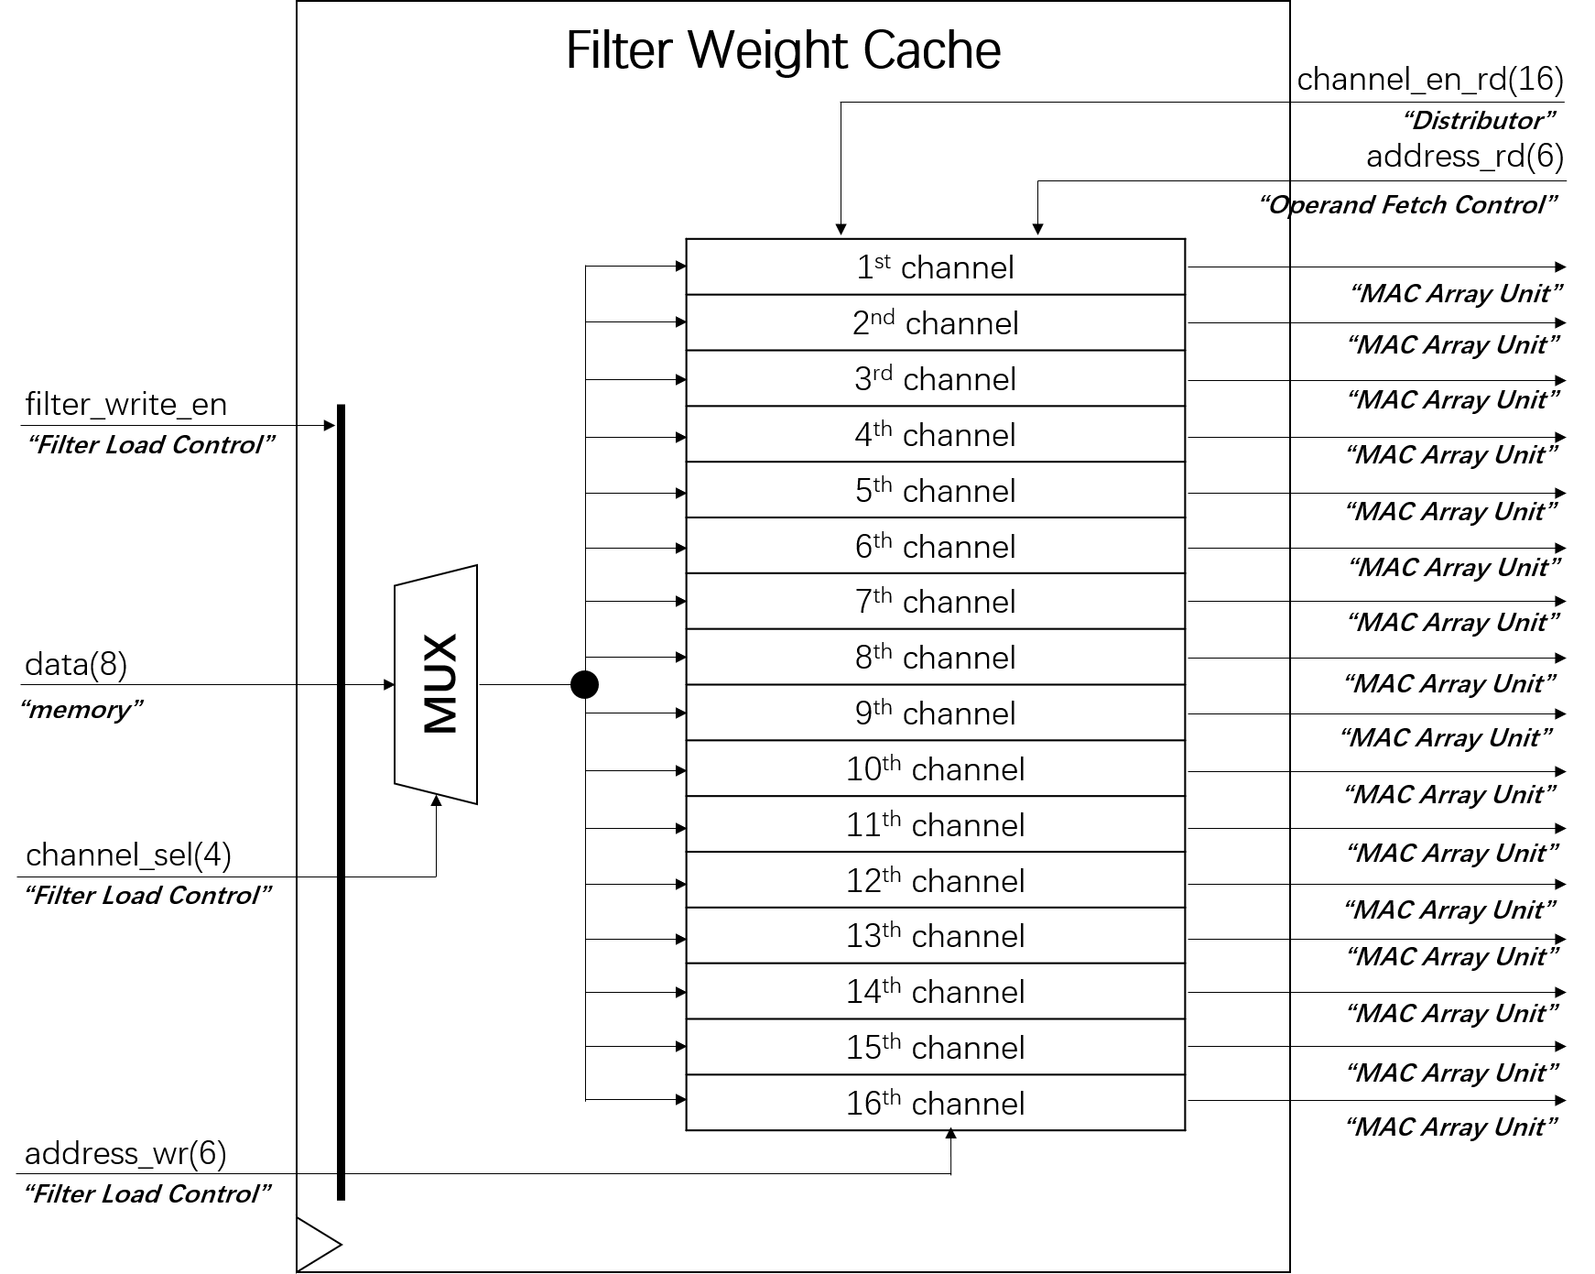
Filter Weight Cache
36 x 16 = 576 Bytes

Slide 86
Quantization

Slide 87
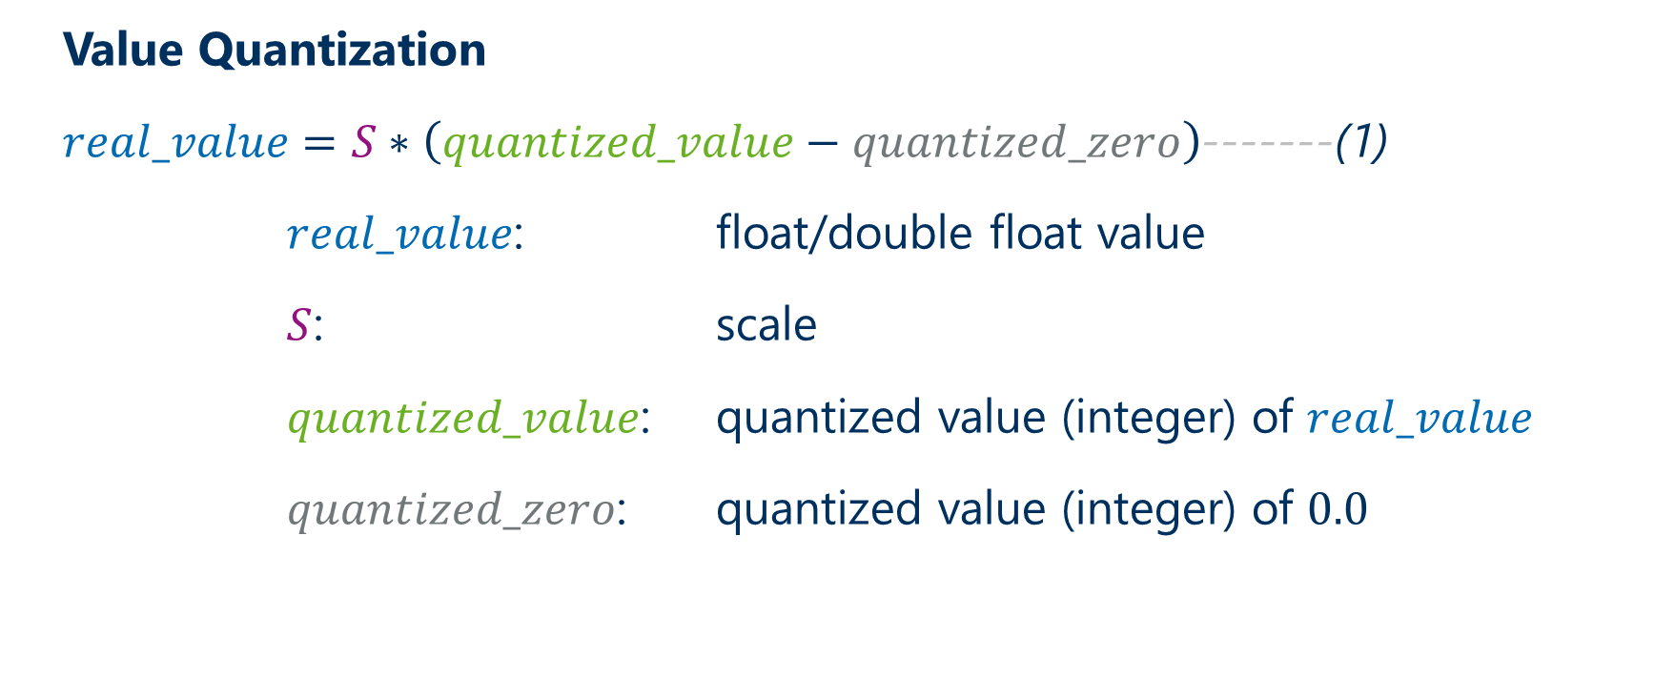
Convolutional Neural Networks (CNNs)
  Value Quantization
  $real_value=S∗\left(quantized_value−quantized_zero\right)$-------(1)
  $real_value$: float/double float value
  $S$: scale
  $quantized_value$: quantized value (integer) of $real_value$
  $quantized_zero$: quantized value (integer) of $0.0$

Slide 88

Convolutional Neural Networks (CNNs)
  Convolution Quantization
  $$Y=X⊗W$$
  $${Y=S}_{X}(X_{q}−X_{q_zero})⊗S_{W}(W_{q}−W_{q_zero})$$
  ${Y=Y\left[i\right]\left[j\right]=S}_{X}S_{W}\sum_{i=1}^{m}{\sum_{j=1}^{m}{\left((X_{q}[i][j]−X_{q_zero}) (W_{q}[i][j]−W_{q_zero}) \right)}}$---(2)
with equation (1)

Slide 89
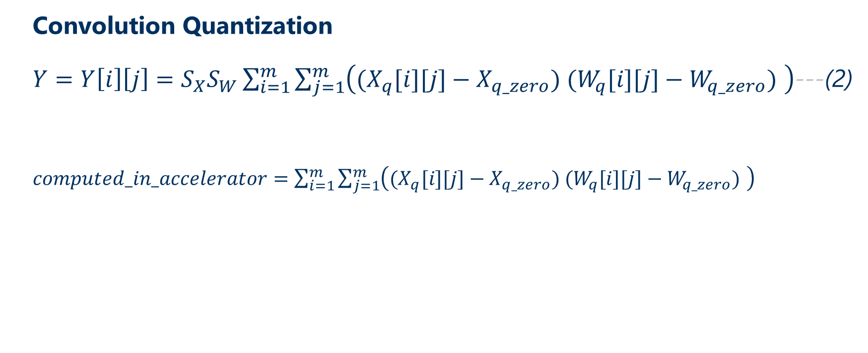
Convolutional Neural Networks (CNNs)
  Convolution Quantization
  ${Y=Y\left[i\right]\left[j\right]=S}_{X}S_{W}\sum_{i=1}^{m}{\sum_{j=1}^{m}{\left((X_{q}[i][j]−X_{q_zero}) (W_{q}[i][j]−W_{q_zero}) \right)}}$---(2)
  $computed_in_accelerator=\sum_{i=1}^{m}{\sum_{j=1}^{m}{\left((X_{q}[i][j]−X_{q_zero}) (W_{q}[i][j]−W_{q_zero}) \right)}}$

Slide 90
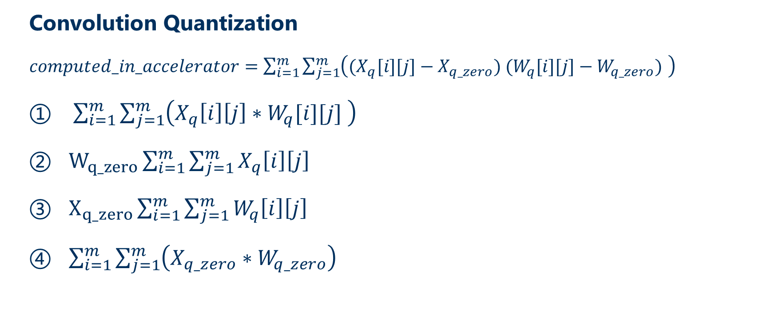
Convolutional Neural Networks (CNNs)
  Convolution Quantization
  $computed_in_accelerator=\sum_{i=1}^{m}{\sum_{j=1}^{m}{\left((X_{q}[i][j]−X_{q_zero}) (W_{q}[i][j]−W_{q_zero}) \right)}}$
  $\sum_{i=1}^{m}{\sum_{j=1}^{m}{\left(X_{q}\left[i\right]\left[j\right]∗W_{q}[i][j] \right)}}$
  $W_{q_zero}\sum_{i=1}^{m}{\sum_{j=1}^{m}{X_{q}\left[i\right]\left[j\right]}}$
  $X_{q_zero}\sum_{i=1}^{m}{\sum_{j=1}^{m}{W_{q}\left[i\right]\left[j\right]}}$
  $\sum_{i=1}^{m}{\sum_{j=1}^{m}{\left(X_{q_zero}∗W_{q_zero}\right)}}$

Slide 91

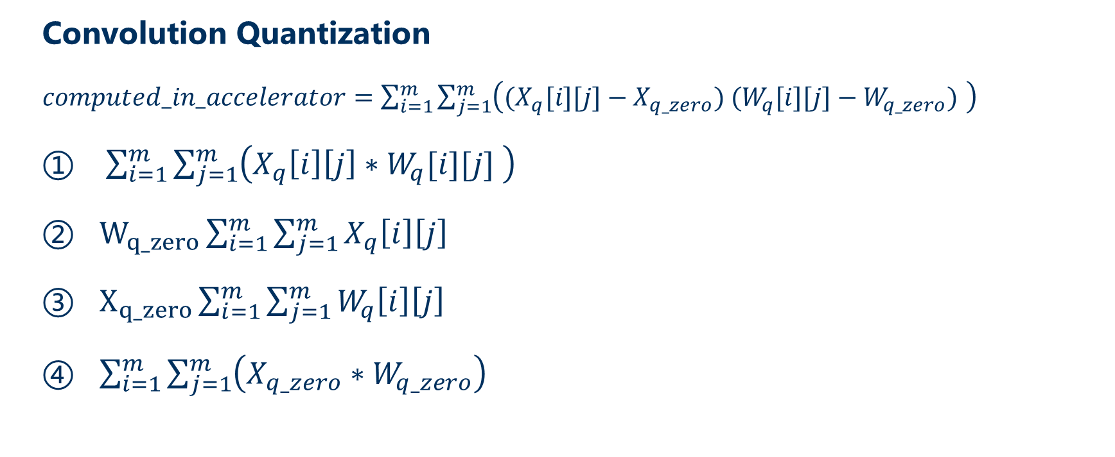
Convolutional Neural Networks (CNNs)
  Convolution Quantization
  $computed_in_accelerator=\sum_{i=1}^{m}{\sum_{j=1}^{m}{\left((X_{q}[i][j]−X_{q_zero}) (W_{q}[i][j]−W_{q_zero}) \right)}}$
  $\sum_{i=1}^{m}{\sum_{j=1}^{m}{\left(X_{q}\left[i\right]\left[j\right]∗W_{q}[i][j] \right)}}$
  $W_{q_zero}\sum_{i=1}^{m}{\sum_{j=1}^{m}{X_{q}\left[i\right]\left[j\right]}}$
  $X_{q_zero}\sum_{i=1}^{m}{\sum_{j=1}^{m}{W_{q}\left[i\right]\left[j\right]}}$
  $\sum_{i=1}^{m}{\sum_{j=1}^{m}{\left(X_{q_zero}∗W_{q_zero}\right)}}$
$X_{q_zero}$ is 0 in Computer Version.

Slide 92

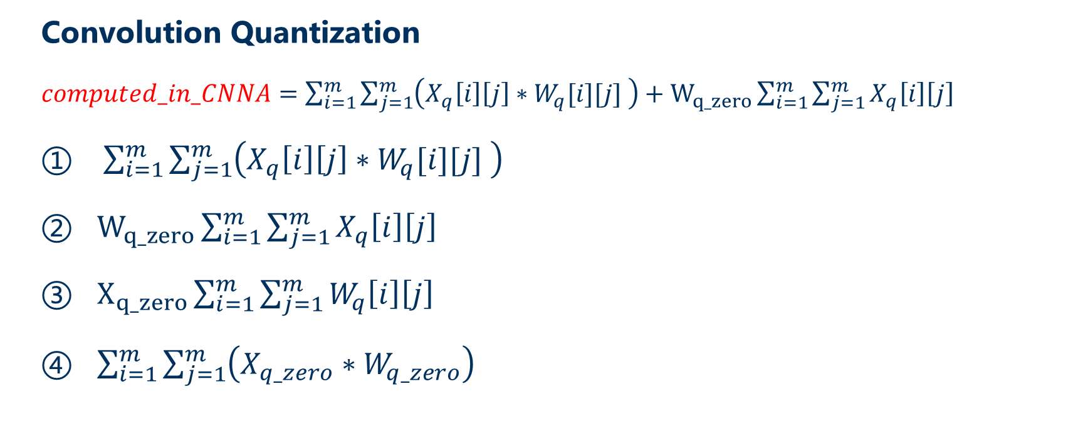
Convolutional Neural Networks (CNNs)
  Convolution Quantization
  $computed_in_CNNA=\sum_{i=1}^{m}{\sum_{j=1}^{m}{\left(X_{q}\left[i\right]\left[j\right]∗W_{q}[i][j] \right)}}+W_{q_zero}\sum_{i=1}^{m}{\sum_{j=1}^{m}{X_{q}\left[i\right]\left[j\right]}}$
  $\sum_{i=1}^{m}{\sum_{j=1}^{m}{\left(X_{q}\left[i\right]\left[j\right]∗W_{q}[i][j] \right)}}$
  $W_{q_zero}\sum_{i=1}^{m}{\sum_{j=1}^{m}{X_{q}\left[i\right]\left[j\right]}}$
  $X_{q_zero}\sum_{i=1}^{m}{\sum_{j=1}^{m}{W_{q}\left[i\right]\left[j\right]}}$
  $\sum_{i=1}^{m}{\sum_{j=1}^{m}{\left(X_{q_zero}∗W_{q_zero}\right)}}$
$X_{q_zero}$ is 0 in Computer Version.

Slide 93
Convolutional Neural Networks (CNNs)
  Convolution Quantization
  ${Y=Y\left[i\right]\left[j\right]=S}_{X}S_{W}\sum_{i=1}^{m}{\sum_{j=1}^{m}{\left((X_{q}[i][j]−X_{q_zero}) (W_{q}[i][j]−W_{q_zero}) \right)}}$---(2)
  $computed_in_accelerator=\sum_{i=1}^{m}{\sum_{j=1}^{m}{\left((X_{q}[i][j]−X_{q_zero}) (W_{q}[i][j]−W_{q_zero}) \right)}}$
The result is not int8 but int32 !!!
In TensorFlow, the result needs to be re-quantized.

Slide 94
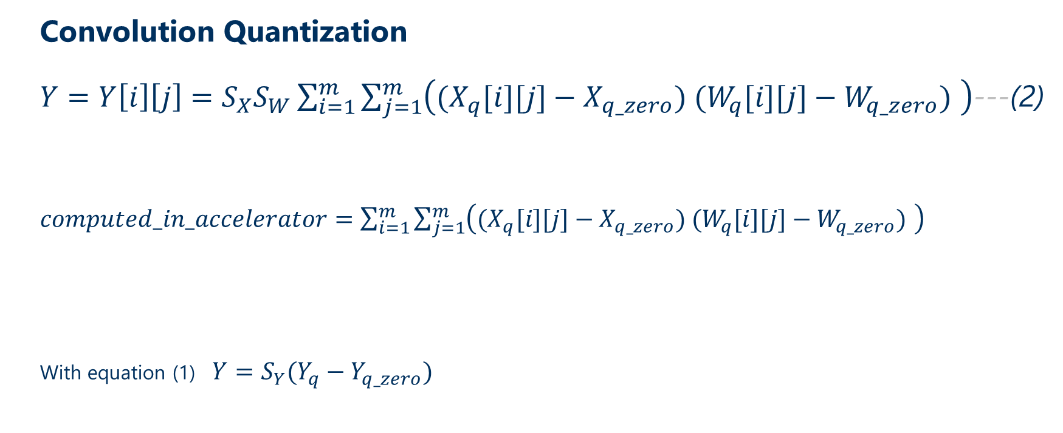
Convolutional Neural Networks (CNNs)
  Convolution Quantization
  ${Y=Y\left[i\right]\left[j\right]=S}_{X}S_{W}\sum_{i=1}^{m}{\sum_{j=1}^{m}{\left((X_{q}[i][j]−X_{q_zero}) (W_{q}[i][j]−W_{q_zero}) \right)}}$---(2)
  $computed_in_accelerator=\sum_{i=1}^{m}{\sum_{j=1}^{m}{\left((X_{q}[i][j]−X_{q_zero}) (W_{q}[i][j]−W_{q_zero}) \right)}}$
  With equation (1) $Y=S_{Y}(Y_{q}−Y_{q_zero})$
The result is not int8 but int32 !!!
In TensorFlow, the result needs to be re-quantized.

Slide 95
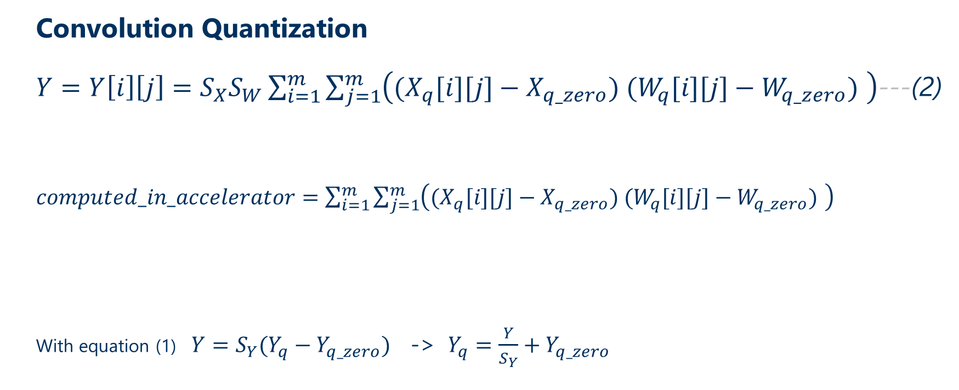
Convolutional Neural Networks (CNNs)
  Convolution Quantization
  ${Y=Y\left[i\right]\left[j\right]=S}_{X}S_{W}\sum_{i=1}^{m}{\sum_{j=1}^{m}{\left((X_{q}[i][j]−X_{q_zero}) (W_{q}[i][j]−W_{q_zero}) \right)}}$---(2)
  $computed_in_accelerator=\sum_{i=1}^{m}{\sum_{j=1}^{m}{\left((X_{q}[i][j]−X_{q_zero}) (W_{q}[i][j]−W_{q_zero}) \right)}}$
  With equation (1) $Y=S_{Y}(Y_{q}−Y_{q_zero})$ -> $Y_{q}=\frac{Y}{S_{Y}}+Y_{q_zero}$
The result is not int8 but int32 !!!
In TensorFlow, the result needs to be re-quantized.

Slide 96

Convolutional Neural Networks (CNNs)
  Convolution Quantization
  With equation (2)
  $$Y_{q}=\frac{Y}{S_{Y}}+Y_{q_zero}$$
  $$=\frac{S_{X}S_{W}\sum_{i=1}^{m}{\sum_{j=1}^{m}{\left((X_{q}[i][j]−X_{q_zero}) (W_{q}[i][j]−W_{q_zero}) \right)}}}{S_{Y}}+Y_{q_zero}$$
  $$Y_{q}=\frac{S_{X}S_{W}∗computed_in_accelerator}{S_{Y}}+Y_{q_zero}$$
We need to know $Y_{q_zero}$ and $S_{Y}$ to get the re-quantized $Y_{q}$.

Slide 97

Convolutional Neural Networks (CNNs)
  Convolution Quantization
  $$Y_{q}=\frac{S_{X}S_{W}∗computed_in_accelerator}{S_{Y}}+Y_{q_zero}$$
  As $S_{X}$ , $S_{W}$and the maximum (255) and minimum (0) value of $Y_{q}$ are known, obtaining the maximum and minimum value of $computed_in_accelerator$, $Y_{q_zero}$ and $S_{Y}$ can be calculated.

